Slide 1

Vellore Institute of Technology , Chennai School of Computer Science and Engineering Herbscan : real time detection and classification of herbal leaves using deep learning models
Student Member
Raj Singh
Reg .No-22MCA1040
Supervisor
Dr R.M . Bhavadharini
Associate Professor Grade 1

Slide 2

APPROVAL MAIL

Slide 3
Abstract
The identification of medicinal leaves is a complex task due to the wide variety of plant species, diverse environmental conditions, and the subtle differences in leaf characteristics.
Historically, medicinal leaf classification has been carried out using manual identification based on botanical knowledge.
Traditional image processing techniques, such as feature extraction and pattern recognition, have been employed but may struggle with the inherent variability in leaf appearances.
Recent advancements in deep learning, particularly Convolutional Neural Networks (CNNs), have demonstrated remarkable success in image classification tasks.
The proposed method combines the strengths of deep learning, object detection, and real-time implementation to create a robust system for medicinal leaf classification, contributing to the automation and efficiency of plant identification in the context of herbal medicine.
Applying object detection to medicinal leaf classification allows for the identification of multiple leaves within a single image, enhancing the system's utility.

Slide 4
Problem Statement
The existing gap in efficient and timely medicinal plant recognition becomes especially evident in crucial domains such as healthcare, where rapid identification of plant species is pivotal for ensuring the safe and effective application of herbal remedies.
The absence of a comprehensive and real-time medicinal plant recognition system poses a hindrance to the broader integration of plant-based remedies into healthcare practices and impedes the efficient monitoring of medicinal plant populations in the wild.
By leveraging the power of advanced frameworks such as TensorFlow, YOLO, OpenCV, or PyTorch , this research project aims to address these challenges by developing a deep learning-based recognition technique tailored for real-time detection of medicinal plants.
The goal is to create a robust and scalable solution that not only accelerates the identification process but also enhances accuracy, providing a valuable tool for diverse stakeholders, from healthcare practitioners to environmental researchers.

Slide 5
The Outline of the contents required for the PPT is given below
Project title (With your name Register Number and Guide Name)
Problem statement
Literature review on the topic Identified (Minimum 10 papers from reputed Journals/Conferences)
Research Objectives Identified
Proposed Solution to the Problem
Architecture Diagram of your Project work
Dataset Description
Modules Identified
Guides Approval Mail screenshot
Status of work to be completed (Timeline Chart)

Slide 6
Introduction
The wealth of biodiversity in the plant kingdom hold immense value for human well-being. Among these, medicinal plants play a pivotal role, offering a vast repository of compounds with therapeutic properties.
The identification and classification of these plants are crucial for various applications, from traditional medicine to modern pharmacology.
Traditional methods of plant identification, relying on manual morphological analysis, have proven to be time-consuming, subjective, and resource-intensive.
In response, this project harnesses the power of deep learning, leveraging frameworks such as TensorFlow, YOLO, OpenCV, or PyTorch, to automate the recognition process.
The chosen approach involves the adaptation of object detection methodologies to the domain of medicinal plants, facilitating not only swift and accurate identification but also enabling real-time applications.
Through this research, we aspire to contribute to the burgeoning field of computer vision applied to botany, fostering advancements that hold promise for both ecological preservation and human well-being.

Slide 7
Literature Survey(1)
A Deep Learning-Based Recognition Technique for Plant Leaf Classification.
(IEEE-Received October 29, 2021, accepted November 27, 2021, date of publication November 30, 2021, date of current version December 16, 2021.)
Algorithms/Technique used
cGAN , classification, convolutional neural networks, deep learning, Logistic Regression.
Result:-
Both Deep Learning and Logistic regression -96.1%
Issues:-
MalayaKew dataset can be found in three very similar classes (Class 2 and 9 are highly similar)

Slide 8
Literature Survey(2)
Deep Learning for Plant Species Classification Using Leaf Vein Morphometric.
(IEEE/ACM TRANSACTIONSONCOMPUTATIONALBIOLOGYANDBIOINFORMATICS,VOL.17,NO.1,JANUARY/FEBRUARY2020)
Algorithms/Technique used
Convolutional Neural Network (CNN) models namely pre-trained AlexNet , fine-tuned AlexNet , and D-Leaf.
Support Vector Machine (SVM), Artificial Neural Network (ANN), k-Nearest-Neighbor (k-NN), Na€ ıve-Bayes (NB), and CNN.
Result:-
The D-Leaf model - 94.88 percent ,as compared to AlexNet (93.26 percent) and fine-tuned AlexNet (95.54 percent) models. In addition, CNN models performed better than the traditional morphometric measurements (66.55 percent)
Issues:-
Training deep CNNs can be time-consuming.
Large Computational Requirements:

Slide 9
Literature Survey(3)
Fast Plant Leaf Recognition Using Improved Multiscale Triangle Representation and KNN for Optimization.
(Received October29,2020,acceptedNovember9,2020,dateofpublicationNovember16,2020,dateofcurrentversionDecember1,2020.
Algorithms/Technique used
Multi-scale triangle representation of which five representations extract contour curvature features TVA and TUA, texture features TGA and TGSD, and shape area feature TSLI from each leaf image.
Result:-
Swedish and Flavia plant leaf datasets, 99.35%and99.43% with 84.76% Mean Average Precision (MAP)
Issues:-
Limited datasets

Slide 10
Literature Survey(4)
Improved Leaf Image Classification Using Topological Features and CNN With Attention Module.
(2021 IEEE 6th International Conference on Signal and Image Processing (ICSIP) | 978-1-6654-3904-6/21/$31.00 ©2021 IEEE | DOI: 10.1109/ICSIP52628.2021.9689038)
Algorithms/Technique used
CNN, deep learning, fine grained image classification , Pi-net.
Result:-
VGG16+Pi-Net – Precision-99.85 , Accuracy-100 , Recall-99 ,F1-Score-100(Flavia)
Precision-99.92, Recall- 100 , Accuracy-100 , F1-Score-100
Issues:-
Not Suitable for Real-Time Applications on Resource-Constrained Devices.
Overfitting Risk

Slide 11
Literature Survey(5)
Joint Plant Instance Detection and Leaf Count Estimation for In-Field Plant Phenotyping.
(IEEE ROBOTICS ANDAUTOMATIONLETTERS,VOL.6,NO.2,APRIL2021)
Algorithms/Technique used
—Deep learning for visual perception, robotics and automation in agriculture and forestry.
Result:-
Mask R-CNN- 96% (Accuarcy)
Issues:-
Fixed Input Size
Inefficiency in Inference
Difficulty in Generalization

Slide 12
Literature Survey(6)
Joint Plant and Leaf Instance Segmentation on Field-Scale UAV Imagery.
(IEEE ROBOTICS ANDAUTOMATIONLETTERS,VOL.7,NO.2,APRIL2022)
Algorithms/Technique used
Robotics and automation in agriculture and forestry, deep learning for visual perception, object detection.
Result:-
CNN-94%(Accuracy) , mAP of 78.2%
Issues:-
Fixed Input Size
Inefficiency in Inference
Difficulty in Generalization

Slide 13
Literature Survey(7)
The Analysis of Plants Image Recognition Based on Deep Learning and Artificial Neural Network.
(Received March 20, 2020, accepted April 7, 2020, date of publication April 9, 2020, date of current version April 23, 2020.)
Algorithms/Technique used
deep learning and artificial neural network (ANN)
Result:-
The proposed method achieves an overall accuracy of 97.5% on the benchmark dataset.
Issues:-
Computational cost
.Overfitting
Lack of interpretability

Slide 14
Literature Survey(8)
An Improved YOLOv5 Algorithm for Wood Defect Detection Based on Attention
(Received 17 May 2023, accepted 13 June 2023, date of publication 10 July 2023, date of current version 19 July 2023)
Algorithms/Technique used
STC-YOLOv5
Result:-
STC-YOLOv5 achieves an mAP of 88.3%, which is 3.1% higher than the original YOLOv5 algorithm.
Issues:-
The algorithm may be sensitive to changes in lighting conditions and image quality.
The algorithm may not be able to detect all types of wood defects, especially those that are very small or subtle.
The algorithm may require a large amount of training data to achieve good performance.

Slide 15
Literature Survey(9)
YOLOv5-Based Model Integrating Separable Convolutions for Detection of Wheat Head Images.
(Received 16 January 2023, accepted 30 January 2023, date of publication 1 February 2023, date of current version 8 February 2023.)
Algorithms/Technique used
YOLOv5-based model integrated with separable convolutions.
Result:-
The proposed method achieves an mAP of 93.8%, which is 4.2% higher than the original YOLOv5 model
Issues:-
Computational Complexity.
Data Dependency.
Sensitivity to Lighting Conditions

Slide 16
Literature Survey(10)
Simplifying VGG-16 for Plant Species Identification.
(IEEE LATIN AMERICA TRANSACTIONS, VOL. 20, NO. 11, NOVEMBER 2022)
Algorithms/Technique used
VGG-16 architecture by removing two fully-connected layers and replacing the flattening layer with a global average pooling layer , reduce the number of trainable parameters in the network from 134 million to 15 million.
Result:-
Reduced training time and computational cost.
Improved performance.
Robustness
Issues:-
Overfitting.
Limited interpretability

Slide 17
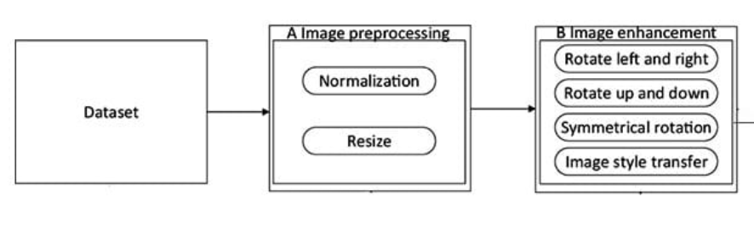
DATASETS
Passing image
Dataflow Diagram
DEEP LEARNING MODEL
Classifying images

Slide 18
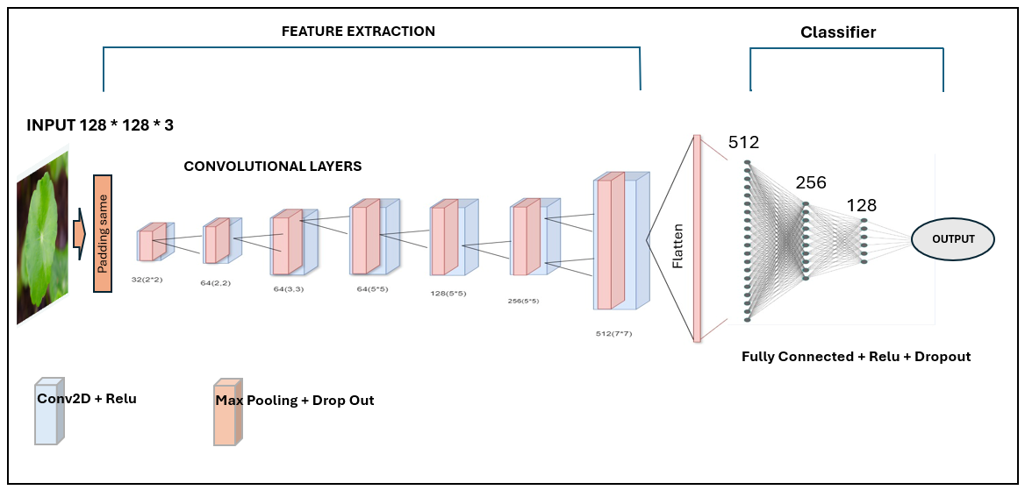
Architecture Diagram

Slide 19
RESEARCH OBJECTIVE
Develop a Robust Classification Model
Explore Transfer Learning Techniques
Enable Real-time Implementation
Integrate Object Detection for Efficiency
Evaluate and Optimize Model Performance
Accurate Medicinal Leaf Classification:
Contribution to Herbal Medicine:

Slide 20
Proposed Solution to The Problem
Data Exploration and Understanding
Data Augmentation Strategies
Deep Learning for Classification:
Transfer Learning:
Hyperparameter Tuning:
Object Detection Integration:
Real-time Implementation
Model Interpretability

Slide 21
MODULES OF THIS PROJECT
MODULES OF THIS PROJECT
Data Collection and Preprocessing
Annotation Tool
Model Development
Model Optimization
Real-Time Processing Pipeline
Performance Evaluation
Comparative Analysis
Deployment

Slide 22
DATSET DISCRIPTION
ALL THE IMAGES WERE GATHERED THROUGH WAVE SCRAPPING
NO 0F CLASSES-43
NO OF IMAGES PER CLASS-300
TOTAL NO OF IMAGES-12,900

Slide 23
Model Implemented using Transfer Learning
RESNET -50(V2)
VGG19
VGG-16
INCEPTION V3

Slide 24
MODEL RESNET-50
NO OF EPOCHS | LOSS | TRAINING ACCURACY | VALIDATION LOSS | VALIDATION ACCURACY | CATEGORICAL ACCURACY | TEST ACCURACY | TEST LOSS
30 | 3.17 | 0.67 | 3.52 | 0.54 | 0.51 | 0.51 | 3.38
40 | 2.17 | 0.70 | 3.14 | 0.58 | 0.56 | 0.57 | 3.16
50 | 1.54 | 0.78 | 2.78 | 0.67 | 0.66 | 0.67 | 2.61
60 | 1.08 | 0.85 | 1.96 | 0.78 | 0.74 | 0.78 | 1.84
70 | 0.54 | 0.91 | 1.18 | 0.85 | 0.83 | 0.83 | 1.23
80 | 0.18 | 0.96 | 0.78 | 0.89 | 0.89 | 0.87 | 0.98
90 | 0.054 | 0.99 | 0.18 | 0.97 | 0.97 | 0.97 | 0.15
100 | 0.018 | 0.99 | 0.18 | 0.97 | 0.97 | 0.97 | 0.15

Slide 25
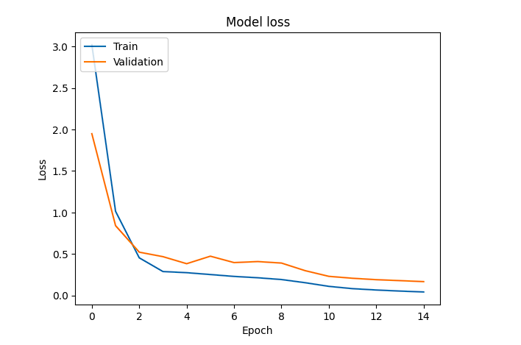
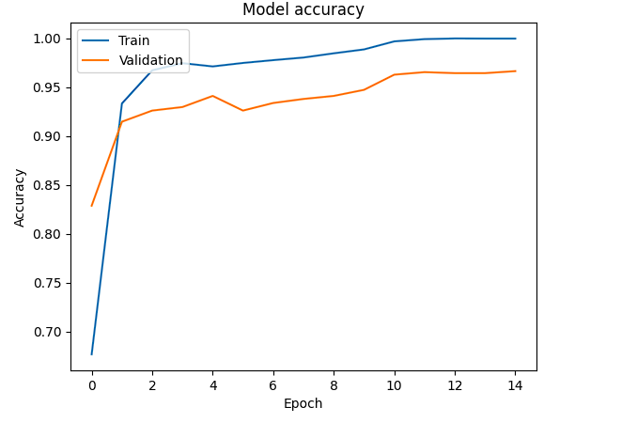
MODEL RESNET-50

Slide 26
MODEL-VGG -19
NO OF EPOCHS | LOSS | ACCURACY | VALIDATION LOSS | VALIDATION ACCURACY | CATEGORICAL ACCURACY | TEST ACCURACY | TEST LOSS
30 | 2.08 | 0.73 | 2.45 | 0.67 | 0.66 | 0.66 | 2.71
40 | 1.86 | 0.77 | 2.01 | 0.79 | 0.79 | 0.77 | 2.01
50 | 1.34 | 0.83 | 1.87 | 0.85 | 0.85 | 0.83 | 1.79
60 | 0.98 | 0.87 | 1.27 | 0.87 | 0.87 | 0.87 | 1.63
70 | 0.63 | 0.91 | 1.23 | 0.89 | 0.89 | 0.89 | 1.23
80 | 0.36 | 0.93 | 1.10 | 0.89 | 0.87 | 0.87 | 1.10
90 | 0.19 | 0.96 | 0.86 | 0.92 | 0.94 | 0.93 | 1.01
100 | 0.19 | 0.99 | 0.71 | 0.94 | 0.99 | 0.94 | 0.89

Slide 27
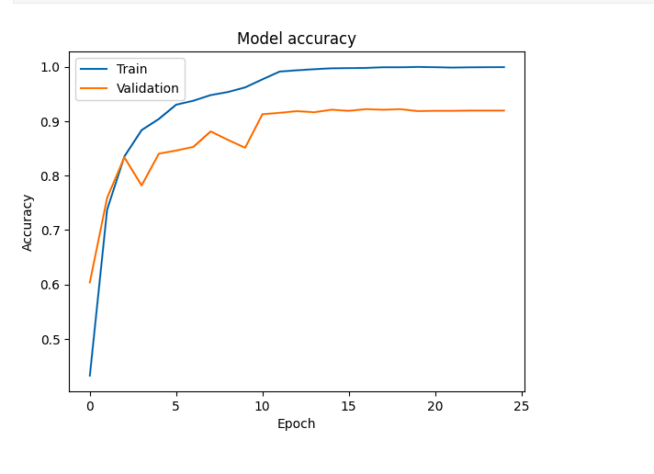
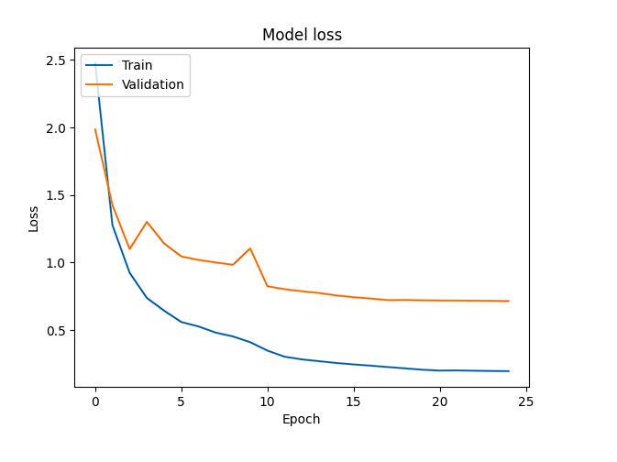
MODEL-VGG -19

Slide 28
MODEL – VGG(16)
NO OF EPOCHS | LOSS | ACCURACY | VALIDATION LOSS | VALIDATION ACCURACY | CATEGORICAL ACCURACY | TEST ACCURACY | TEST LOSS
30 | 2.78 | 0.68 | 2.84 | 0.61 | 0.61 | 0.59 | 3.01
40 | 2.04 | 0.73 | 2.27 | 0.67 | 0.67 | 0.65 | 2.16
50 | 1.78 | 0.77 | 1.89 | 0.76 | 0.76 | 0.73 | 1.80
60 | 1.39 | 0.81 | 1.67 | 0.79 | 0.79 | 0.77 | 1.56
70 | 1.21 | 0.84 | 1.19 | 0.84 | 0.85 | 0.84 | 1.29
80 | 1.17 | 0.86 | 1.19 | 0.84 | 0.84 | 0.80 | 1.19
90 | 0.82 | 0.94 | 0.85 | 0.91 | 0.91 | 0.91 | 0.56
100 | 0.13 | 0.99 | 0.59 | 0.96 | 0.96 | 0.94 | 0.32

Slide 29
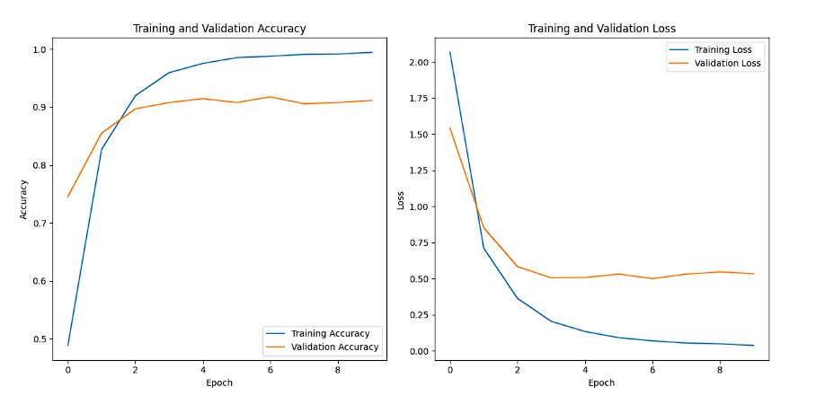
MODEL – VGG(16)

Slide 30
MODEL –INCEPTION (V3)
NO OF EPOCHS | LOSS | ACCURACY | VALIDATION LOSS | VALIDATION ACCURACY | CATEGORICAL ACCURACY | TEST ACCURACY | TEST LOSS
30 | 1.67 | 0.67 | 2.13 | 0.63 | 0.65 | 0.63 | 2.21
40 | 1.13 | 0.73 | 1.79 | 0.69 | 0.71 | 0.69 | 1.78
50 | 0.89 | 0.80 | 1.14 | 0.78 | 0.78 | 0.78 | 1.31
60 | 0.66 | 0.83 | 0.78 | 0.83 | 0.88 | 0.83 | 1.17
70 | 0.58 | 0.85 | 0.80 | 0.83 | 0.88 | 0.87 | 1.12
80 | 0.18 | 0.91 | 0.77 | 0.88 | 0.94 | 0.91 | 1.08
90 | 0.04 | 0.99 | 0.46 | 0.91 | 0.96 | 0.91 | 0.59
100 | 0.008 | 0.99 | 0.46 | 0.91 | 0.99 | 0.93 | 0.37

Slide 31
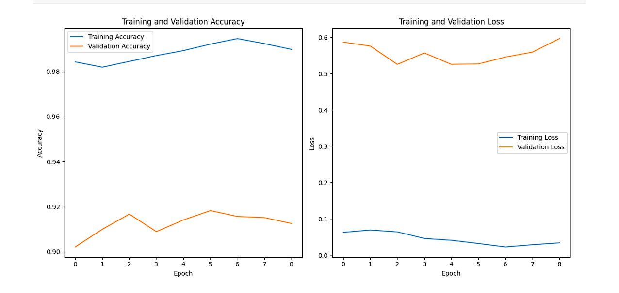
MODEL –INCEPTION (V3)

Slide 32
SELF-DEFINED SEQUENTIAL MODEL
NO OF EPOCHS | LOSS | ACCURACY | VALIDATION LOSS | VALIDATION ACCURACY | TEST ACCURACY | TEST LOSS | Precision | Recall | Categorical Accuracy
40 | 2.89 | 0.58 | 2.89 | 0.51 | 0.49 | 3.01 | 0.57 | 0.49 | 0.59
50 | 2.19 | 0.64 | 2.47 | 0.56 | 0.56 | 2.78 | 0.63 | 0.59 | 0.64
60 | 1.69 | 0.70 | 2.17 | 0.63 | 0.59 | 2.29 | 0.71 | 0.64 | 0.71
70 | 1.25 | 0.76 | 1.94 | 0.71 | 0.69 | 2.01 | 0.78 | 0.71 | 0.79
80 | 1.15 | 0.86 | 1.64 | 0.83 | 0.81 | 1.17 | 0.81 | 0.77 | 0.83
90 | 0.99 | 0.95 | 1.04 | 0.89 | 0.86 | 0.69 | 0.87 | 0.84 | 0.89
100 | 0.49 | 0.95 | 0.64 | 0.89 | 0.89 | 0.55 | 0.96 | 0.95 | 0.96

Slide 33
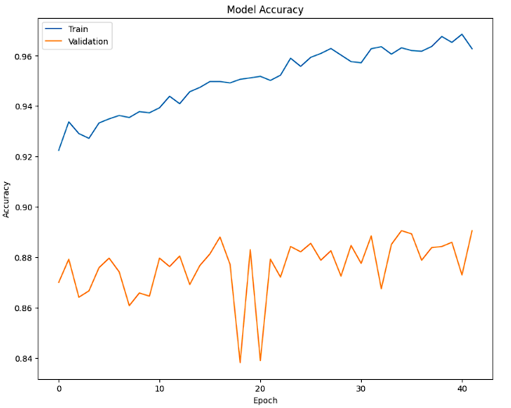
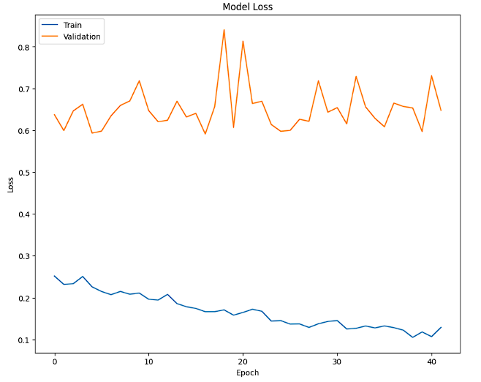
SELF-DEFINED SEQUENTIAL MODEL

Slide 34
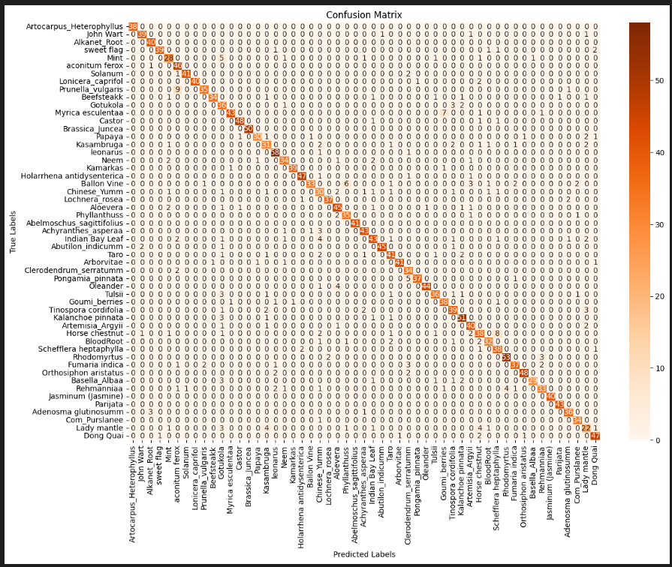
Confusion Matrix obtained after training the Self defined sequential Architecture

Slide 35
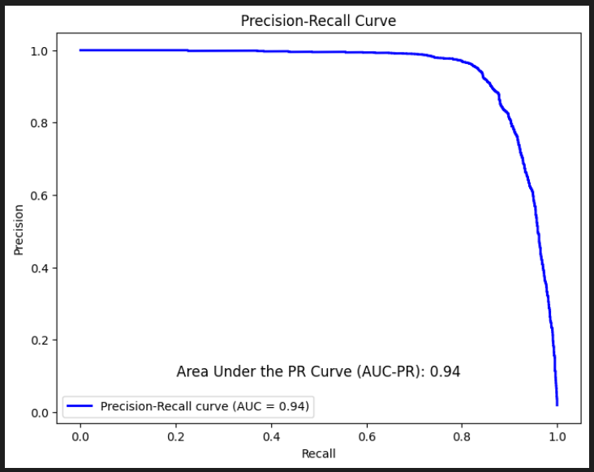
Precision Recall curve obtained after training the model

Slide 36
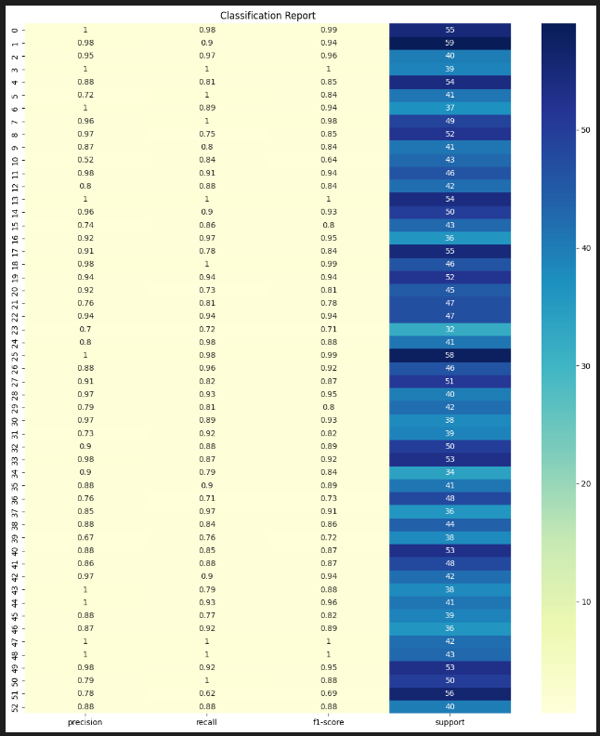
Precision Recall and f1-Score across all the Class

Slide 37
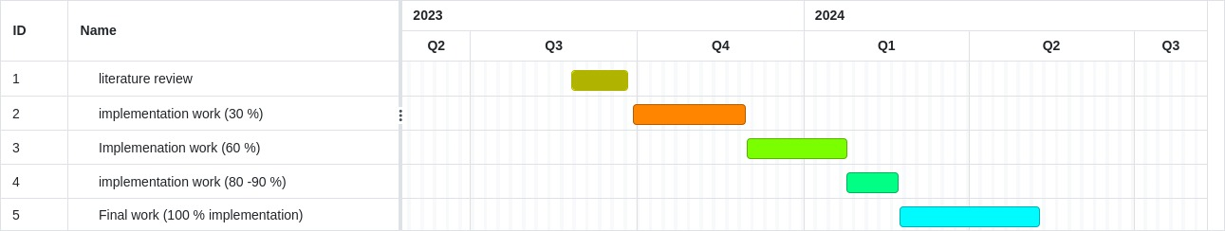
Timeline Chart

Slide 38
REFERENCES
Kanda PS, Xia K, Sanusi OH. A deep learning-based recognition technique for plant leaf classification. IEEE Access. 2021 Nov 30;9:162590-613.
Wei Tan J, Chang SW, Abdul-Kareem S, Yap HJ, Yong KT. Deep learning for plant species classification using leaf vein morphometric. IEEE/ACM transactions on computational biology and bioinformatics. 2018 Jun 19;17(1):82-90.
Su J, Wang M, Wu Z, Chen Q. Fast plant leaf recognition using improved multiscale triangle representation and KNN for optimization. IEEE Access. 2020 Nov 12;8:208753-66.
Zhang Y. Improved Leaf Image Classification Using Topological Features and CNN With Attention Module. In2021 IEEE 6th International Conference on Signal and Image Processing (ICSIP) 2021 Oct 22 (pp. 311-315). IEEE.
Weyler J, Milioto A, Falck T, Behley J, Stachniss C. Joint plant instance detection and leaf count estimation for in-field plant phenotyping. IEEE Robotics and Automation Letters. 2021 Feb 19;6(2):3599-606.
Weyler J, Quakernack J, Lottes P, Behley J, Stachniss C. Joint plant and leaf instance segmentation on field-scale UAV imagery. IEEE Robotics and Automation Letters. 2022 Feb 1;7(2):3787-94.
Huixian J. The analysis of plants image recognition based on deep learning and artificial neural network. IEEE Access. 2020 Apr 9;8:68828-41.
Han S, Jiang X, Wu Z. An improved YOLOv5 algorithm for wood defect detection based on attention. IEEE Access. 2023 Jul 10.
Shen R, Zhen T, Li Z. YOLOv5-Based Model Integrating Separable Convolutions for Detection of Wheat Head Images. IEEE Access. 2023 Feb 1;11:12059-74.
Campos-Leal JA, Yee-Rendón A, Vega-López IF. Simplifying VGG-16 for plant species identification. IEEE Latin America Transactions. 2022 Sep 28;20(11):2330-8.

Slide 39
Thankyou

